Slide 1
CSC 180 Final Project
Instant feedback on Amazon review
Cody, Brian, Kevin

Slide 2
Introduction
Our project aim to help customer and seller to evalvate how well a product is doing it
From the seller pespective, it gives feedback and helps making improvments
From the customer side, it shows what is good about the product
The goal is to be able to predict the upvotes based off the reviews left on the product

Slide 3
Dataset
The dataset collected from Amzaon
http://snap.stanford.edu/data/web-Amazon.html
Jun 1995 - Mar 2013, Over 18 years
Beauty product
Approximately 252,056 reviews

Slide 4
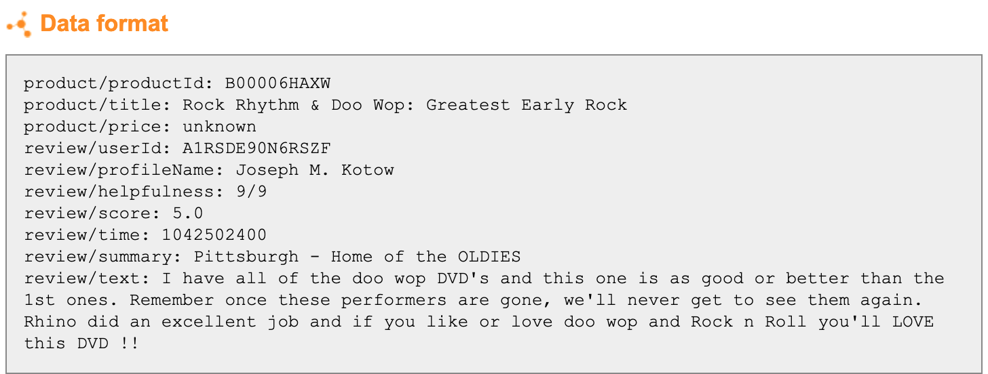
Dataset

Slide 5





Methodology

Slide 6
Methodology
Spilt data into 80% for traning and 20% for testing
3 models
TF-IDF
TF-IDF with word embedding
GloVe pre-trained word embedding
Compare the result using
Regression chart
RSME score

Slide 7
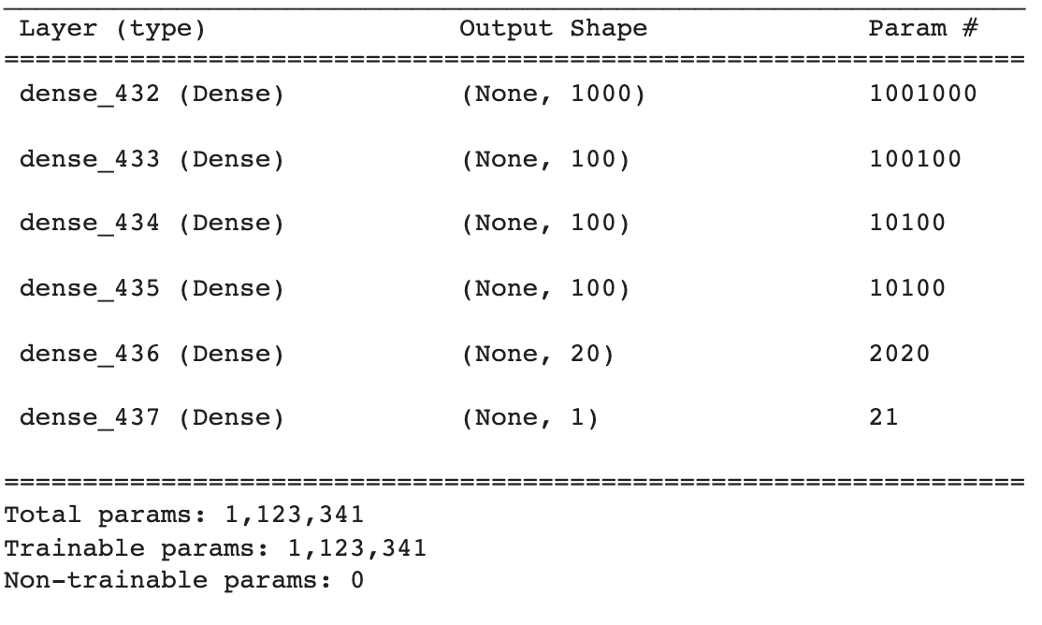
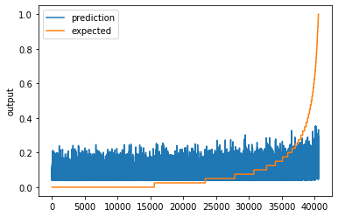
Result / Analysis
TF-IDF
MSRE score: 0.1277255153365108

Slide 8
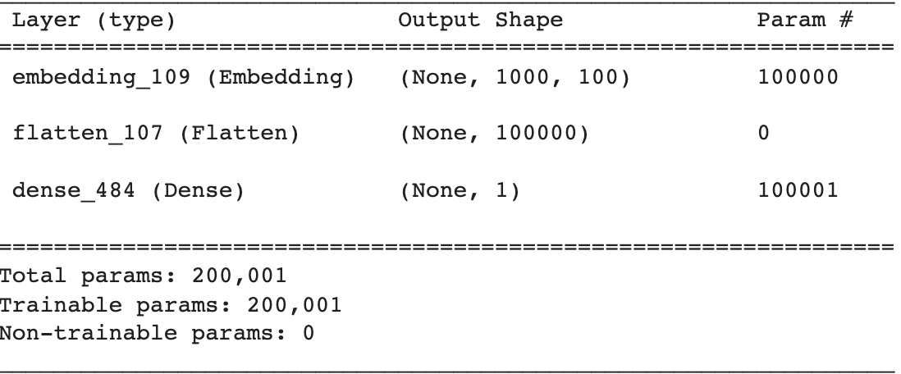
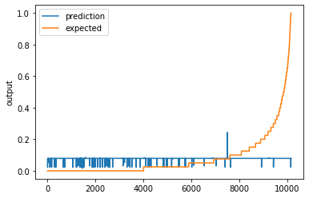
Result / Analysis
TF-IDF with word embedding
MSRE score: 0.14436161635685488

Slide 9
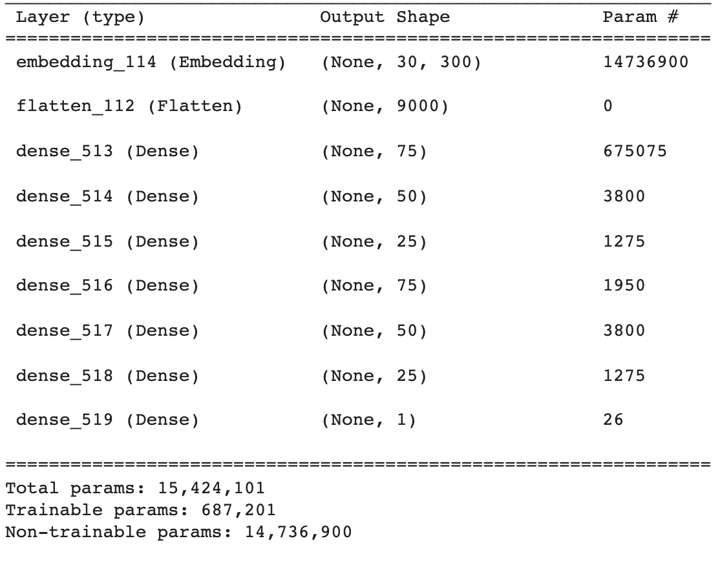
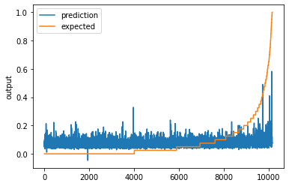
Result / Analysis
GloVe pre-trained model MSRE score: 0.14238823781875248

Slide 10
Result / Analysis
Despite multiple attempt to reconfigure data and adjust paramter, we are unable to model that could predict a review was worthy of helpfulness upvote on Amazon
Reasons
review text plays a small factor
product owner might upvote only the reviews they like
reviewer’s friend helped making fake numbers

Slide 11
Any Question?
Q & A time

